Slide 1

Internship Presentation
On
“LPG Refilling Prediction”
Presented By:
Prakhar Kumar Chandraker
    1VI19CS070
VIII Sem ‘B’ Section
Department of CSE, Vemana IT
Guided By:
Ms. Veena G
    Assistant Professor
Department of CSE, Vemana IT

Slide 2
Contents
2022 - 2023
Abstract
Introduction
Organization overview
Implementation
Results
Conclusion
Bibliography
29-Mar-23
Department of CSE, Vemana IT
1
Notes:
25-10-2017
Department of CSE, Vemana IT
Title

Slide 3
Abstract
2022 - 2023
The system aims to streamline the process of booking LPG cylinder refills for households in India.
It will leverage predictive analytics and automation technologies to generate refill requests automatically. The system will use data on usage patterns, refill frequency, amount of LPG used, and the number of members in each household to accurately predict the next refill date.
By eliminating the need for manual bookings, the system will reduce wait times and improve the customer experience.
The use of advanced technologies such as machine learning and data analytics will also reduce the chances of foul play by gas agencies or distributors.
29-Mar-23
Department of CSE, Vemana IT
2
Notes:
25-10-2017
Department of CSE, Vemana IT
Title

Slide 4
Introduction
2022 - 2023
Proposed system automates LPG cylinder refill bookings.
Predictive analytics used to generate refill requests based on usage data.
System reduces wait times and improves customer experience.
Advanced technologies used, including ML and data analytics.
User-friendly interface accessible through mobile app or web portal.
Scalable system can handle a large number of households.
Collaboration between stakeholders is required for successful deployment.
29-Mar-23
Department of CSE, Vemana IT
3
Notes:
25-10-2017
Department of CSE, Vemana IT
Title

Slide 5
Organization overview
2022- 2023
Anspro Technology is a good venue for technical learners, internships, workshops and other career growing opportunities.
Anspro Technology appears to be a dynamic and innovative organization that is committed to delivering value to its clients through its expertise in software development and other related services.
The objective of Anspro technology is to ensure that the students get exposure to the industrial environment, current technology relevant to the subjects, opportunities to learn, understand and sharpen real time technical and managerial skills.
29-Mar-23
Department of CSE, Vemana IT
4
Notes:
25-10-2017
Department of CSE, Vemana IT
Title

Slide 6
2022- 2023
Implementation
Import the necessary libraries, including Pandas for data manipulation for machine learning.
Load the LPG dataset into a Pandas DataFrame.
Preprocess the data by removing missing values, scaling the data, and splitting the data into training and testing sets.
The SVR and Ridge algorithms are applied to the selected features to generate refill requests based on usage patterns.
29-Mar-23
Department of CSE, Vemana IT
5

Slide 7
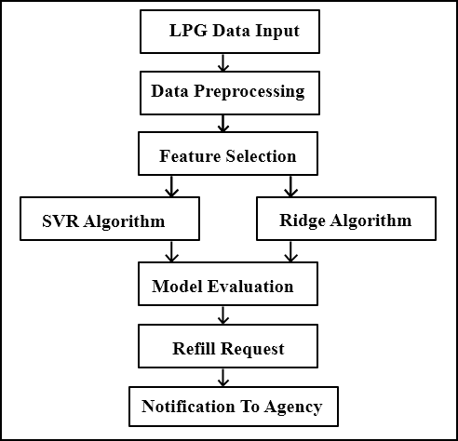
ARCHITECTURE DIAGRAM
2022- 2023
Fig 1.1 - Architecture diagram of LPG Refilling Prediction
29-Mar-23
Department of CSE, Vemana IT
6

Slide 8
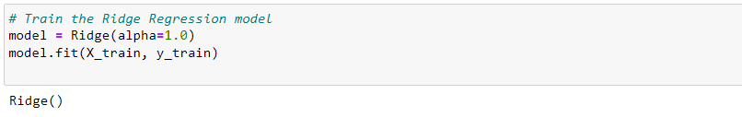
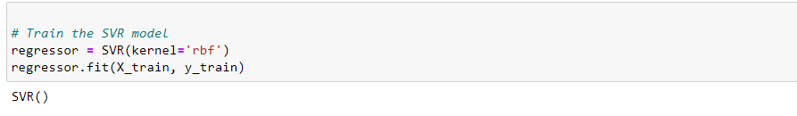
Results
2022- 2023
Fig 1.2 Training SVR and Ridge Model
In Fig 1.2 A Ridge model and SVR model is trained using the dataset provided to Predict the Average number of days it will take to refill a customers cylinder.
Department of CSE, Vemana IT
7
29-Mar-23

Slide 9
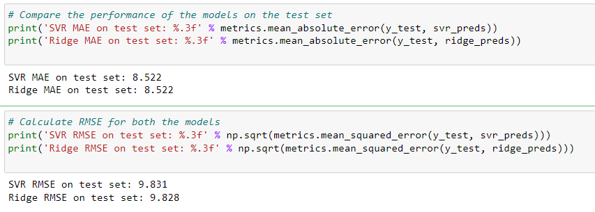
Results
2022- 2023
Fig 1.3 MAE & RMSE of the models
Fig 1.3 shows the Mean Absolute Error (MAE) & Root Mean Squared Error (RMSE) Of SVR and Ridge Model. This Shows that both are almost same.
Department of CSE, Vemana IT
8
29-Mar-23

Slide 10
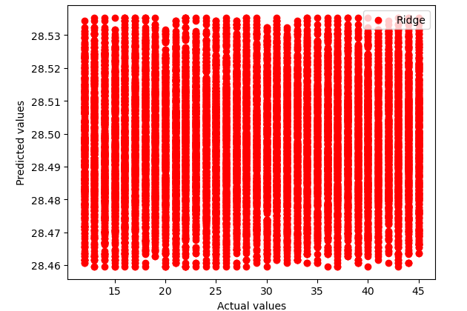
Results
2022- 2023
Fig 1.4 Graph of Ridge Model
Figure 1.4 shows the graph of Ridge Model which compares Predicted Values to Actual Values.
Department of CSE, Vemana IT
9
29-Mar-23

Slide 11
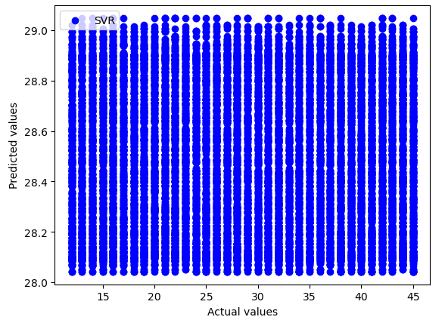
Results
2022- 2023
Fig 1.5 Graph of SVR Model
Figure 1.5 shows the graph of SVR Model which compares Predicted Values to Actual Values.
Department of CSE, Vemana IT
10
29-Mar-23

Slide 12
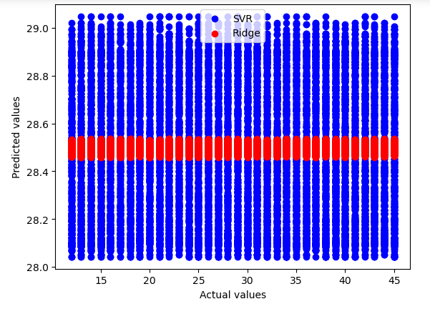
Results
2022- 2023
Fig 1.6 Graph Comparing SVR & Ridge Model
Fig 1.6 shows the Comparison graph between SVR Model and Ridge Model in which compares Predicted Values to Actual Values.
Department of CSE, Vemana IT
11
29-Mar-23

Slide 13
Conclusion
2022- 2023
The project aimed to create a machine learning model to predict the number of days for LPG gas cylinder refill based on family size, usage history, and refill history.
The project used Ridge and SVR algorithms for prediction both having approximately same RMSE and MAE.
The developed model can help customers in planning their gas usage and providers in ensuring timely and efficient delivery of services.
Machine learning algorithms can be effective in solving real-world problems, and data analysis is crucial in making informed decisions.
Department of CSE, Vemana IT
12
29-Mar-23

Slide 14
Bibliography
2022-2023
Hu, Xudong & Sikdar, Biplab. (2021). Sub-Group Based Machine Learning for Gas Consumption Prediction. 1-6. 10.1109/CSDE53843.2021.9718475.
Li, Jiahao & Zhong, Weizhen & Zhu, Dalin & Zhu, Caida & Zhou, Cheng & Zhong, Jiebin & Zhu, Jianwei & Jiang, Dazhi. (2022). Natural Gas Consumption Forecasting Based on KNN-REFCV-MA-DNN Model. 10.1007/978-981-19-4109-2_22.
Gaweł, Bartłomiej & Palinski, Andrzej. (2021). Long-Term Natural Gas Consumption Forecasting Based on Analog Method and Fuzzy Decision Tree. Energies. 14. 10.3390/en14164905.
De Keijzer, Brian & de Visser, Pol & Garcia Romillo, Victor & Muñoz, Víctor & Boesten, Daan & Meezen, Megan & Rahola, Tadeo. (2019). Forecasting residential gas consumption with machine learning algorithms on weather data. E3S Web of Conferences. 111. 05019. 10.1051/e3sconf/201911105019.
Department of CSE, Vemana IT
13
29-Mar-23

Slide 15
THANK YOU
2022- 2023
Department of CSE, Vemana IT
14
29-Mar-23
Notes:
Title
25-10-2017
Department of CSE, Vemana IT

